Slide 1
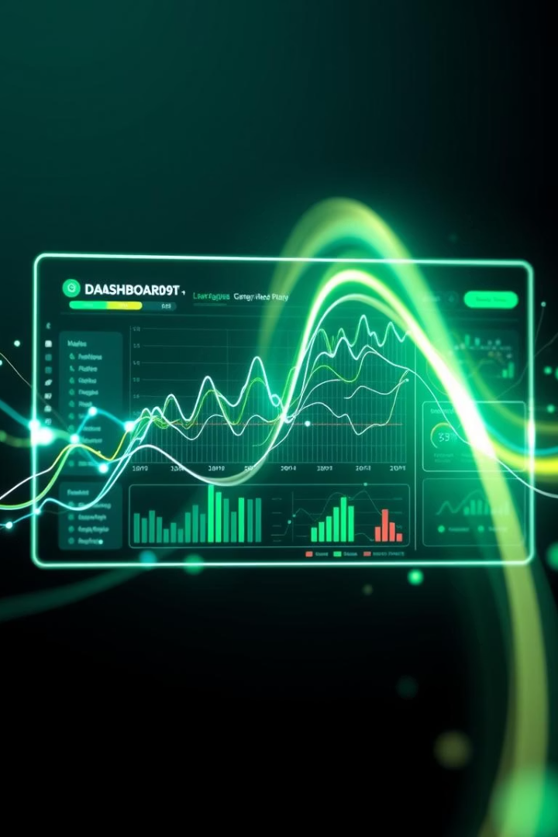
IT Salary Dashboard – A Data Analysis Project Built with Streamlit & Python
This presentation details the development of an interactive IT Salary Dashboard. It provides dynamic visualizations for HR and tech executives. The dashboard helps explore compensation trends across the IT industry.

Slide 2
Project Overview
Project Summary This project focuses on building an interactive dashboard using Python and Streamlit to analyze IT salary data collected across multiple years in the EU region. We used two separate CSV files as our primary data sources: • IT Salary Survey EU 2020.csv (data from 2018 to 2020) • IT Salary Survey EU 2018.csv (data from 2018 and earlier) These files were merged and cleaned to form one consolidated dataset used in our dashboard. Project Objectives:
Combine historical IT salary data for deeper insights
Analyze trends across gender, seniority, and company type
Build a responsive dashboard that enables real-time filtering and exploration

Slide 3





Tools Used in the Project
Python
Pandas
Seaborn/Matplotlib
Used for robust data manipulation and analysis.
Provided essential data structures and tools for cleaning.
Enabled sophisticated data visualization and plotting.
Streamlit
Facilitated rapid, interactive dashboard development.

Slide 4
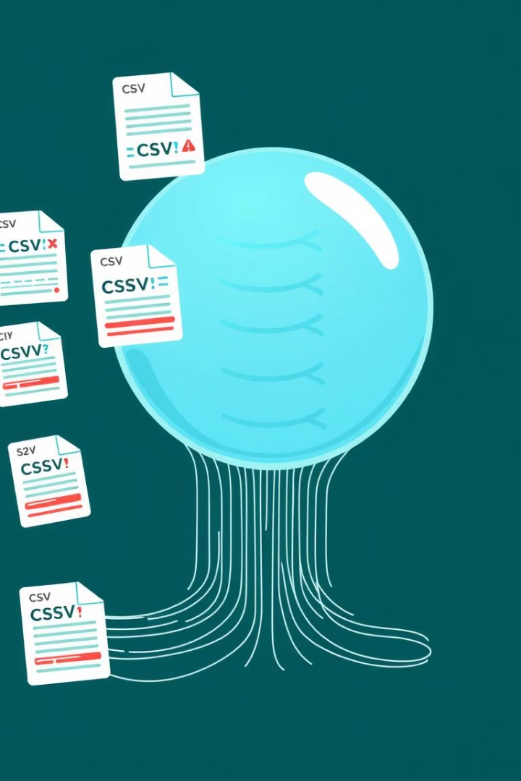




Importing & Appending CSV Data
Collect Files
Multiple CSV files gathered from various sources.
Initial Append
Attempted to merge files into a single dataset.
Encountered Issues
Inconsistent column structures, missing values, and encoding.
Required Handling
Pandas cleaning functions, data type checks, and alignment.

Slide 5

Cleaning & Preparing the Dataset
Final Preparation
Correct Data Types
Prepared the cleaned dataset for deeper analysis.
Standardize Columns
Handle Nulls
Adjusted data types for accurate analysis and calculations.
Identified and addressed all missing values effectively.
Ensured consistent naming and structure across columns.

Slide 6








Exploratory Data Analysis (EDA)
Salary Ranges
Experience Levels
Examined the distribution of salaries across different roles.
Analyzed how experience correlates with compensation.
Visualization Decisions
Job Titles
EDA directly informed dashboard visualization choices.
Investigated salary variations based on specific job titles.

Slide 7
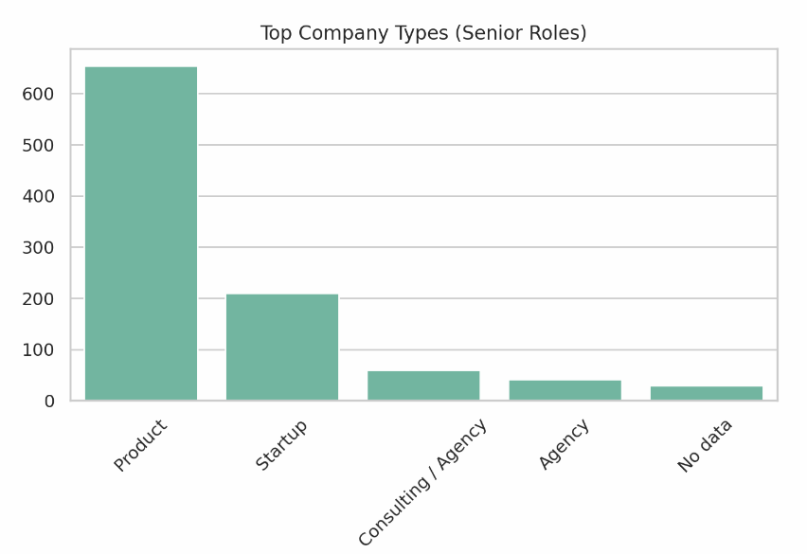
Exploratory Data Analysis (EDA)
Exploratory Data Analysis was performed to identify : • Top Company Types by senior roles • Salary distribution by role • Gender and seniority representation • Trends in bonuses • City-wise experience and average.

Slide 8
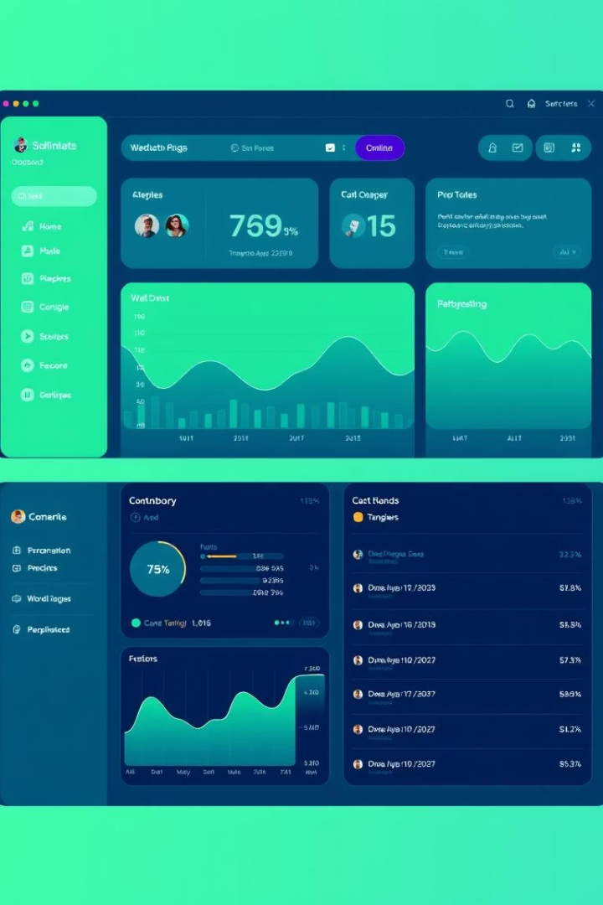
Building the Streamlit Dashboard
1
Layout Structure
Organized the dashboard for intuitive user experience.
2
Sidebar Filters
Integrated dynamic filters for Gender, City, Seniority, Company Type.
3
Dynamic Charts
Implemented interactive visualizations that update with filters.
4
Key Performance Indicators
Displayed essential metrics for quick insights.

Slide 9
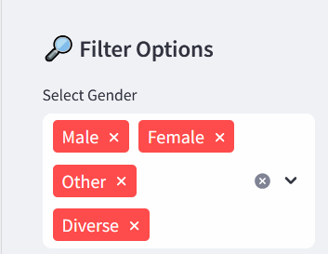
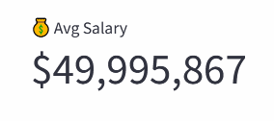
Building the Streamlit Dashboard
📌 Interactive Sidebar Filters
Users can filter data based on Gender, City, Company Type, and Seniority Level.
These filters dynamically adjust all visualizations and metrics on the dashboard.
📈 Real-Time KPI Cards
Display key performance indicators like:
👥 Total Employees
💰 Average Salary (screenshot shown)
📈 *Average Experience
KPIs update instantly based on user-selected filters.

Slide 10
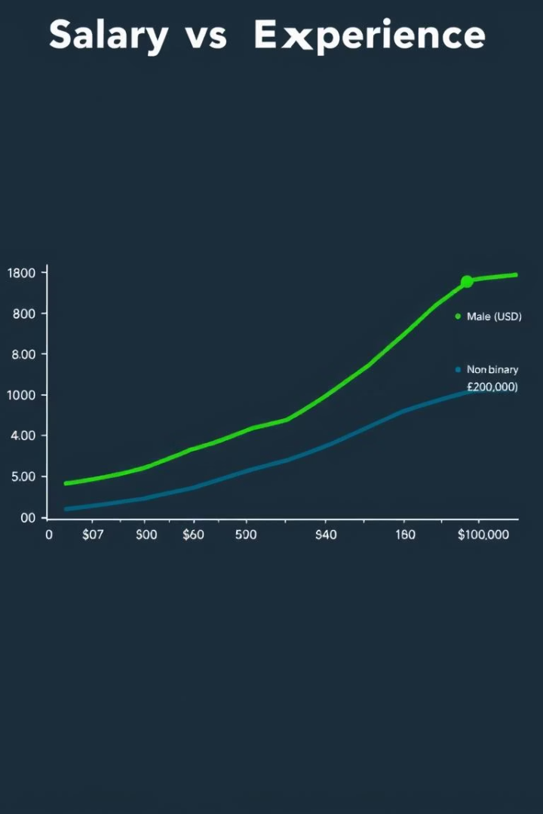
Key Insights from the Dashboard
Gender Pay Gap
City Salary Variations
Identified disparities in compensation across genders in certain roles.
Revealed significant salary differences between major IT hubs.
Seniority Impact
Confirmed higher compensation for increased seniority and experience.

Slide 11
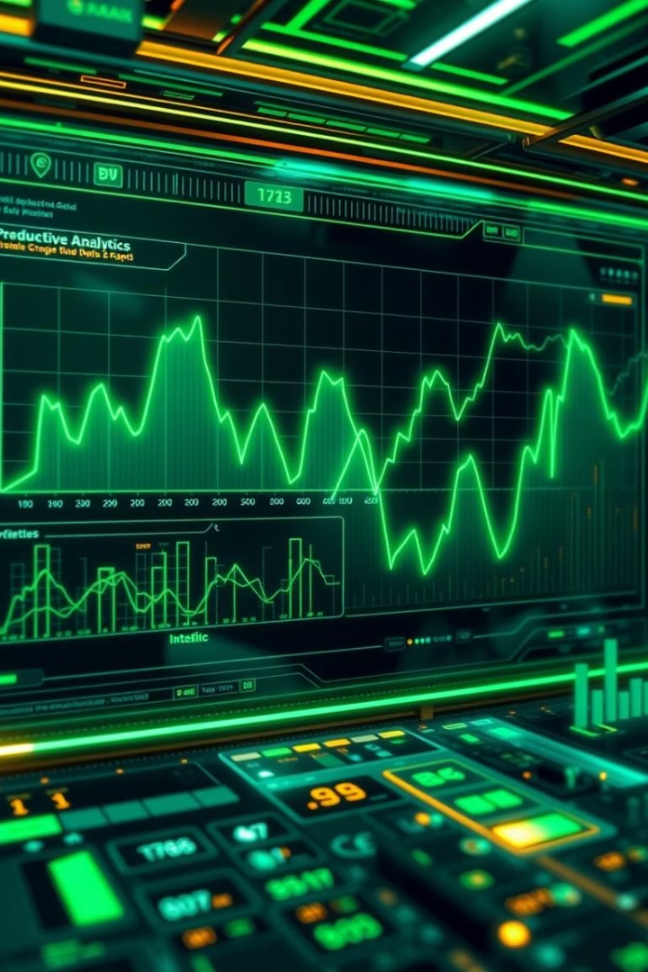



Future Enhancements
More Data Sources
Integrate additional external salary datasets.
Predictive Analytics
Implement machine learning for salary predictions.
Advanced Visualizations
Add complex, interactive charts and graphs.

Slide 12

Conclusion & Next Steps
1
2
3
Project Success
Actionable Data
Continuous Improvement
Dashboard offers valuable IT compensation insights.
Empowers HR and executives with clear trends.
Future plans include expanded data and features.

